Slide 1
Java 8 – SE 1 Presentation
Chapter 5 – Class design

Slide 2
Previous questions leftover
Question: Why can a parameter name be the same with the field name in a class ?
Answer:
- As we discussed before, the ... of field is ... and the ... of parameter is ... => This is confirmed in Java Specification (link note 1)
- The question that we are asking right now was mentioned in .... book => This is a phenomenon called ...ing (I forgot abt this ☺ )
- A field is considered as ... in a code ... if there are any ... that has the ... name with the ... name (link note 2)
- In order to access shadowed ..., ... name must be used
Notes:
Note 1: https://docs.oracle.com/javase/specs/jls/se8/html/jls-6.html#jls-6.3:~:text=The%20scope%20of%20a%20declaration%20of,the%20method%2C%20constructor%2C%20or%20lambda%20expression.
Note 2: https://docs.oracle.com/javase/specs/jls/se8/html/jls-6.html#jls-6.3:~:text=Example%C2%A06.4.1%2D1.%C2%A0Shadowing%20of%20a%20Field%20Declaration%20by%20a%20Local%20Variable%20Declaration

Slide 3
Introducing class inheritance
- When we create a new ... in Java, we could ... that class to "..." other existing ...
=> We call this as ...
- Inheritance is a ... where a ... inheriting all ... from ... (this include ... and ...) – (although all ... have been inherited but some of them won't be able to ... due to ...)
- For example, a class Z inherit a class A => Class Z is called ... and class A is called ...
– Java support ... inheritance => which mean that each of the ... can only have ...
- Java also support mutli ... => Which mean that a class can ... other class and that other class can ...
- Java doesn't support ... inheritance (means that a class can have ...) because it causes ... and harder to ...
- If we want a class that can't be ... by other ... => use ... keyword

Slide 4
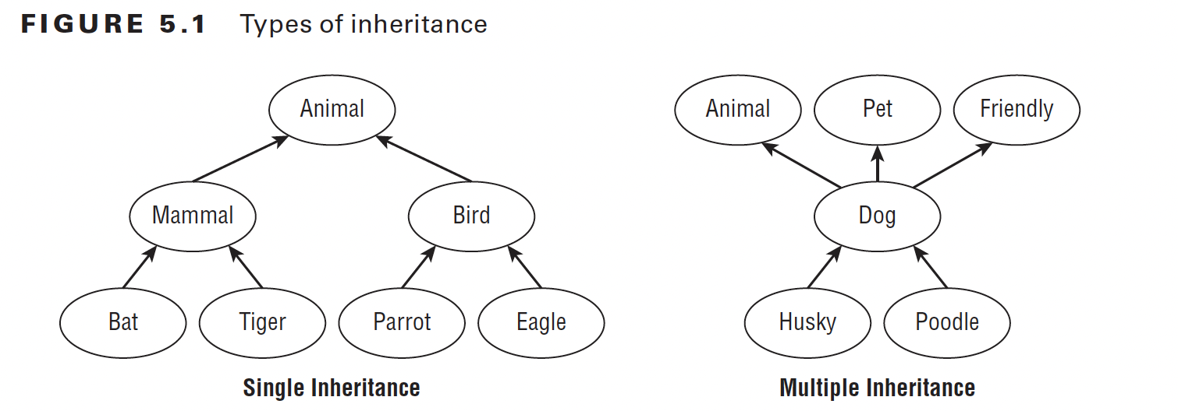
Introducing class inheritance

Slide 5
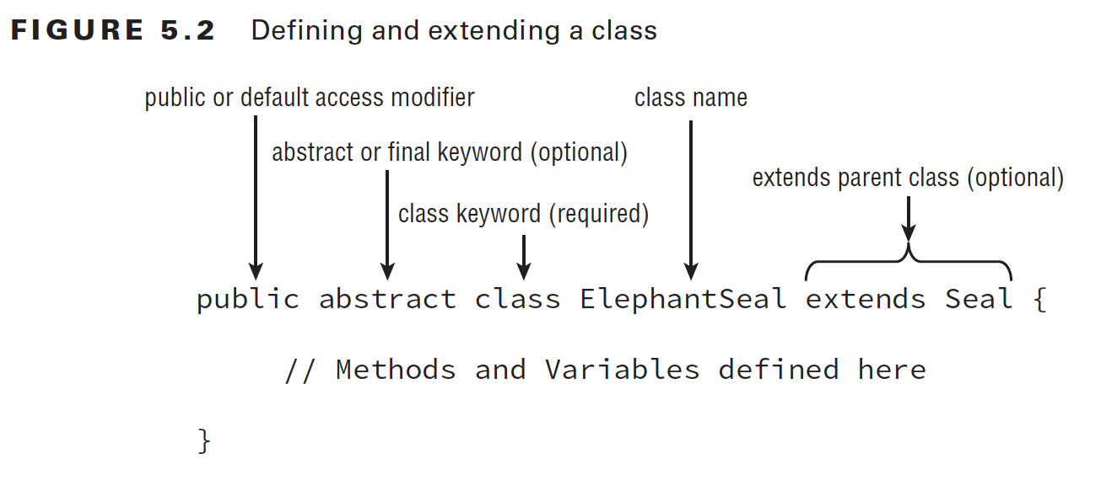
Introducing class inheritance – extending a class
- This picture below is the ...
(code illustration snippet 1)

Slide 6
Introducing class inheritance – extending a class
- Although not all ... can be ... from Lion, but Lion still ... all of ... from Animal class => Technically, we can base on this and conclude that Lion object is ... than Animal object because Lion object has ... from ... and also have its ... (although not all ...)

Slide 7
Introducing class inheritance – Apply access modifier
- With all ... of modifiers that we have studied => we could ... in class
- Note: In OCA exam, we only use ... and ... modifier for ... classes (which is the ... classes), the others are used in ... classes (classes where the ...) which are out of scope of OCA exam
– If a class uses ... modifier => ?
- If a class uses ... modifier => ?
– A ... file can have many ... but can only have ... class => The ... file name must be ... with the class that have ... modifier
– An ... of using ... modifier is that we can have multiple ... within only ... file
(code illustration snippet 2)
- All ... for modifier are also ... to interface

Slide 8
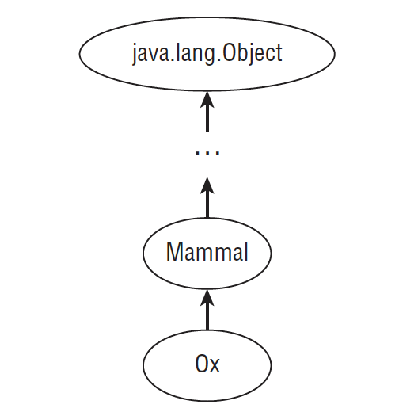
Introducing class inheritance – Creating Java Objects
- No matter how hard we try, all classes will ... the "..." class.
- Because the ... class is the 2nd ... class => It won't ... any other class => it will automatically ... "..." class
- Object class is the only class that ...
(code illustration snippet 3)

Slide 9
Introducing class inheritance – Defining constructor
- In normal case, if a class that doesn't have ... => ... will automatically ...
- However, in inheritance, things will behave differently
– In inheritance, the 1st ... of the ... will have ... cases:
+) Case 1: It will call other ... within a ...
+) Case 2: It will call to the ... of the ... class (If the ... class ... requires param => ... also requires param). This case happen because of a idiom:
"If a ... wants to be ..., ... must be ... first"
(code illustration snippet 4 – 5)
- If the ... class has multiple ... => the child class can use the ... class constructor at any context (as long as they pass in ...)
(code illustration snippet 6)

Slide 10
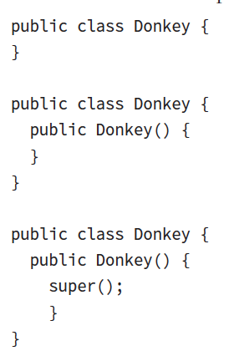
Introducing class inheritance – Understanding Compiler enhancement
- If a class doesn't create its ... => Compiler will ... and also add to the first ...
– If a class does create its ... but doesn't include ... => Compiler will ...
=> In all ..., the compiler will ... likes this picture

Slide 11
Introducing class inheritance – Understanding Compiler enhancement
- However, what happen if the parent class only have ... (and that ... requires ...) and the ...class doesn't have any ...
=> The compiler won't need to ... at the parent class because it ..., however, when it try to ... at the subclass, it sees that the parent class only has ... while the ... that it is trying to ... doesn't requires parameter => ...
(code illustration snippet 7 – 8 – 9)
- Reviewing constructor rule:
+) ... (ask question Q5)
+) ...
+) ...
+) ...
+) ...

Slide 12
Introducing class inheritance – Calling constructor
(code illustrations snippet 10)

Slide 13
Introducing class inheritance – Calling inherited class member
- Java classes always have ... access to the ... of the ... class (if they have ... and ... ....). If the ... class and the ... class are also in the same ... => they can also have ... access
- However, once the ... are set with ... modifier => no ... (unless the class has ...)
(code illustration snippet 11)
- If the inherited field has a ... => We can refer to them ... or by using ... keyword
- We can also ... to inherited field from ... by using ... keyword
(code illustration snippet 12 – 13 - 14)
- the ... "super" and the ... "super()" are completely different. One is used for ... and one is used for ... => They are not ...
(code illustration snippet 15)

Slide 14
Introducing class inheritance – Overriding a method
- As I mentioned in the beginning of the presentation, "inheritance" is a .... => which means that it also ...
- What happen if we ... same method on both ... class and ... class ? => We could do that by Overidding the method
- Override is when we re-... a method on ... class that has the same ... with the ... of the method on ... class
- If we want to call ... on the parent class => we use ... keyword
(code illustration snippet 16)
- Some rules when ... a method:
+) ...
+) ...
+) ...
+) ...
– Method ... and Method ... are albeit the same, however Method ... is different from Method ... when using .... Method ... must use ... while Method ... can alter ... => Freely to use ...
(code illustration snippet 17 – 18 – 19)

Slide 15
Introducing class inheritance – Redeclaring a "private" method
- ... a ... method from parent class is impossible. However, it doesn't mean that we can't create ... as the method on ... class
- However, it won't be Method ... anymore, it will be a ... => which means that all rules from Method ...
(code illustration snippet 20)

Slide 16
Introducing class inheritance – Hiding Static Method
- Hiding static method is the same as Method ..., except for an additional rule for Method ... rule:
+) The context of using "..." keyword in ... class must be the ... as when using in ... class
For example: The method in ... class is using ... => The method in the ... class must be .... If the method in ... class doesn't use ... => the method on the ... class is also ...
(code illustration snippet 21 - 22)
Ask question about "Overriding VS Hiding Methods" section (Q1, 2)

Slide 17
Introducing class inheritance – Creating final method
- The use of "final" ... in method is means that ...
– A method should only be ... as "final" only when we sure that the ... of the method in ... class won't ... when ... to the ... class. (use mammal as an example)
(code illustration snippet 23)

Slide 18
Introducing class inheritance – Overriding VS Hiding (present again)
- With overriding, when ... method with ... object (the reference could be ... or ...), it will always ... to the ... version (no matter where we ...)
(code illustration snippet 35)
- With hiding, the book assume that we ... method by using ... name => Now, which version is ... will depend on ...
+) If we call at..., the ... version will be called
+) If we call at..., the ... version will be called
(code illustration snippet 36)
- With hiding however, if we use ... and ... instead of simple name, there will be ... cases:
+) If the ... and ... is subclass type => ... (this is why they call this as "..." because the ...class version won't never get ....ed from a ...class type...)
+) If the ... and ... is parent-class type => ...
=> In order to ... the ... version, we have ... ways (as java specification said, link note 4)
+) ...
+) ...
(code illustration snippet 37)
Notes:
Note 4: https://docs.oracle.com/javase/specs/jls/se8/html/jls-8.html#jls-8.4.8.2:~:text=A%20hidden%20method%20can%20be%20accessed%20by%20using%20a%20qualified%20name%20or%20by%20using%20a%20method%20invocation%20expression%20(%C2%A715.12)%20that%20contains%20the%20keyword%20super%20or%20a%20cast%20to%20a%20superclass%20type.

Slide 19
Introducing class inheritance – Hiding variable (present again)
- Hiding variable is when we set a ... in ... class that has a name that ... match with the ... in ... class
- There are ... cases when ...ing hidden ...
+) If we access the hidden ... using the ... style =>
- If we use ... and ... that has a type of ... class => The ... class version will be used
(If the ... class version used => we said that the ... version is ...)
- If we use ... and ... that has a type of ... class => The ... class version will be used
(code illustration snippet 38)
- If we want to use the ... class version (according to Java Specification), we can use these ...:
+) Use ... if the field is "static"
+) Use ... that contain "super" ...
+) Use ...st
(link note 5)
(code illustration snippet 39)
Notes:
Note 5: https://docs.oracle.com/javase/specs/jls/se8/html/jls-8.html#jls-8.3:~:text=A%20hidden%20field%20can%20be%20accessed%20by%20using%20a%20qualified%20name%20(%C2%A76.5.6.2)%20if%20it%20is%20static%2C%20or%20by%20using%20a%20field%20access%20expression%20that%20contains%20the%20keyword%20super%20(%C2%A715.11.2)%20or%20a%20cast%20to%20a%20superclass%20type.

Slide 20
Introducing class inheritance – Hiding variable (present again)
+) If we access the hidden ... using the style, the problem will depend on the nature of ...
- According to Java Specification, "this" is a ... not a reference .... Instead of saving ..., it just "specify" ... value that pointing to the current ... that ... method (the method that contains ... keyword)
(There is high chance that the "reference value" that Java Specification use is the word equilvalent to ... that points to the current ... in RAM, this is assumption, might not be totally correct)
- The key point is that, the type of "this" will depend on ...
=> We will have ... cases if we use ... style:
*) The getter from ... class is ...ed by ... class: This time, when we ... the getter using subclass ... (doesn't matter if we use ...class or ...class reference and where do we ... it), the ...class version of the getter will always ...
=> The type of "this" will be ... and the ... that "this" is pointing to is ... => The ... will be used
(code illustration snippet 40)
*) The getter from ... class is only ...ed by ... class: This time, when we ... the getter using subclass ... (doesn't matter if we use ...class or ...class reference and where do we ... it), the ...class version of the getter will always ...
=> The type of "this" will be ... and the ... that "this" is pointing to is ... => This is a valid ...st => Satisfy the ... stated in Java specification => the ... will be used
(code illustration snippet 41)

Slide 21
Creating Abstract class
- Lets say for example, we want to create a ... class for other devs to .... Our objective is to provide some ... and ... for the devs to use. And then, devs will ... the provided ... or create .... Also, we want our class can't ...
=> We can ... by using "abstract" ...
- In Abstract ..., we have a ... called Abstract...
– Abstract method is a method where ...
(code illustration snippet 24)

Slide 22
Creating Abstract class – Defining an Abstract class
- Unlike what I have been taught with Abstract class definition (which is ...), however, an Abstract class can have ...
(code illustration snippet 25)
– Class that use ... keyword => Can't ...ed
– Class that use "Abstract" ... => Must be ...
=> When ... these 2 keywords => there will be ...
(code illustration snippet 26)
- ... keyword are not also applicable to ...
(code illustration snippet 27)
- Abstract method doesn't work with ... because if we set it to ... => There will be no ... concept => ...
(code illustration snippet 28 - 29)
- An abstract class is only useful when ... => The class that ... the abstract class are called "..." because it is the first ... class that ... the abstract class
– All class that ... the abstract class are required to ...
(code illustration snippet 30 - 31)

Slide 23
Creating Abstract class – Extending an abstract class
(code illustration snippet 32)
- An ... abstract class can ... other ... abstract class => When we doing this, the ... abstract class won't need to ... the ... on the ... abstract class
– If there are any concrete ... that ... the ... abstract class => that concrete ... will have to ... from both ...
(code illustration snippet 33)
- However, there are 1 .... If all ... from parent abstract class that has been ... by the sub-abstract class => the concrete class won't have to ...
(code illustration snippet 34)
- The reason for this is because when the ... abstract class ... the method from the ... abstract class => When a concrete class .. the ... abstract class => the method that the ... class ... down will be the ... version not the ... version
- Rules for Abstract class:
+) ... (Ask question , Q7 – also check package part1.q7)
+) ...
+) ...
+) ...
+) ...

Slide 24
Creating Abstract class – Extending an abstract class
- Rule for Abstract method:
+) ...
+) ...
+) ...
+) ...
(Fact: ... and "abstract" keyword can't .... as Java ... said. This is due to the nature of ... keyword, which doesn't have ...ing but instead we got ...ing => incompatible with ...) (link note 3)
Notes:
Note 3: https://docs.oracle.com/javase/specs/jls/se8/html/jls-8.html#jls-8.4.3.1:~:text=It%20is%20a%20compile%2Dtime%20error%20if%20a%20method%20declaration%20that%20contains%20the%20keyword%20abstract%20also%20contains%20any%20one%20of%20the%20keywords%20private%2C%20static%2C%20final%2C%20native%2C%20strictfp%2C%20or%20synchronized.

Slide 25
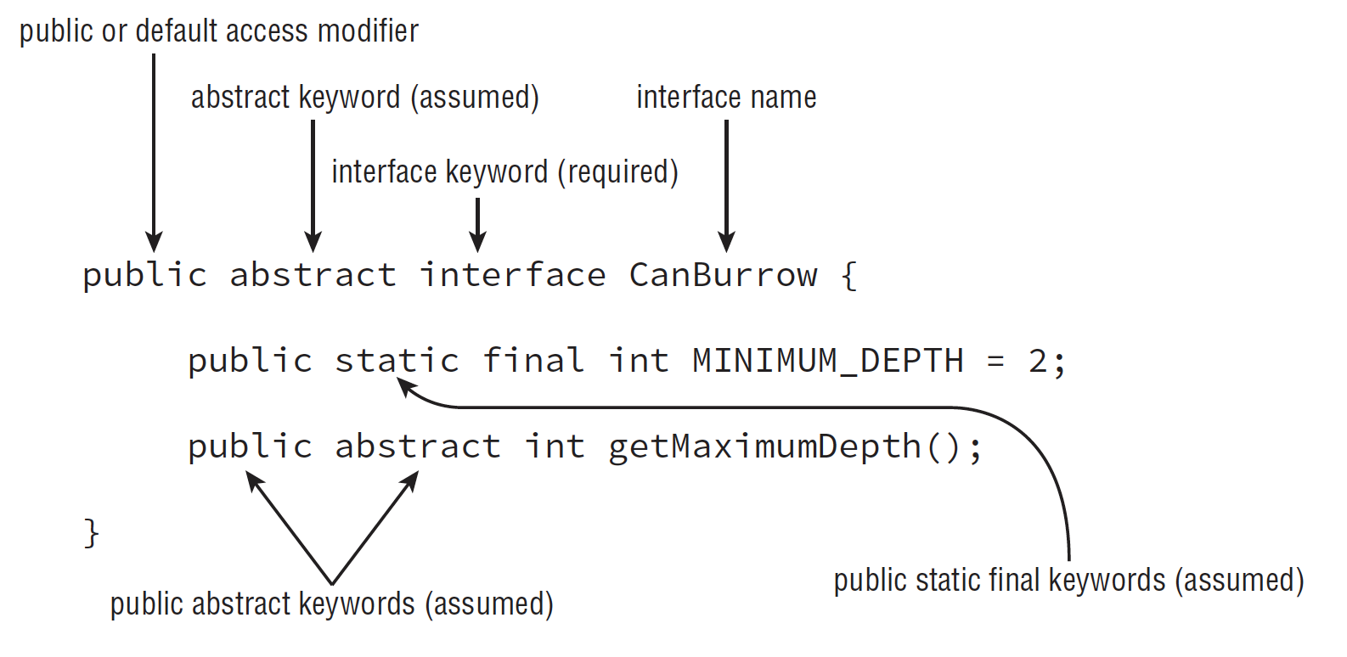
Implementing Interface
- Although Java doesn't allow multiple..., Java does allows us to .... multiple Interfaces
- Interface is a type of ... data type that ... a list of ... method for other classes to ...
- Interface can also contains ... and ...
- In Java, an Interface is ... using "..." keyword, just like a class is ... using "..." keyword
– A class ... an interface using "..." keyword
(But I still like to use the way we think interface as a contract, much more friendly apporach) (check the public modifier below and explain it)

Slide 26
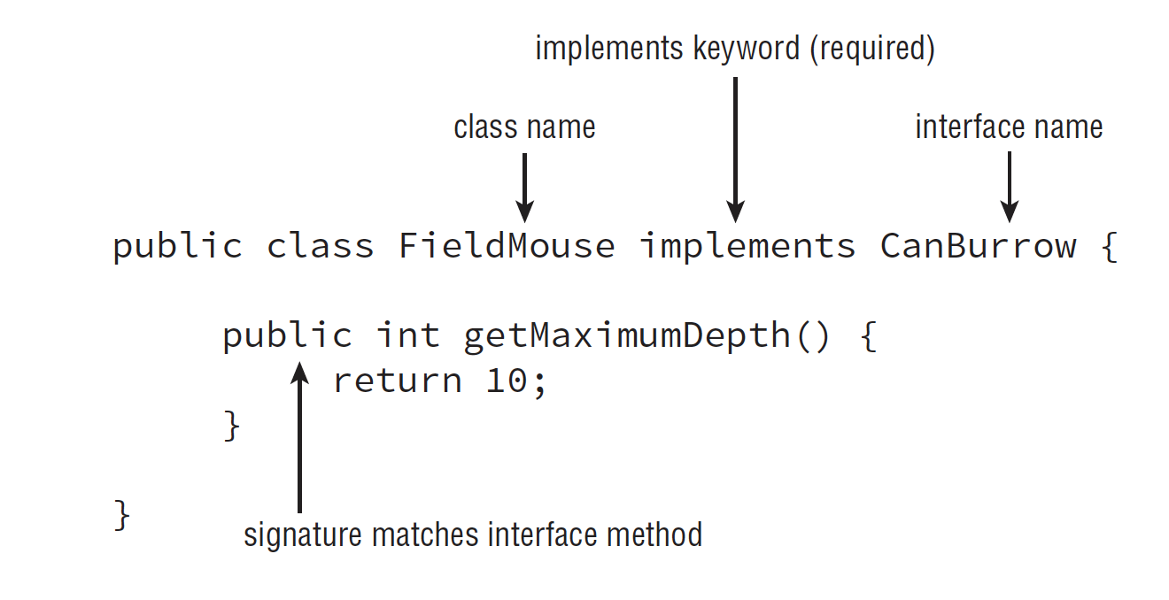


Implementing Interface

Slide 27
Implementing Interface
- As you have seen in the previous picture, an Interface is not ...ed as a ... class, although that interface and ... class is albeit ...
- Notice that the ... inside the interface is assumed to have ... and ... keyword. The problem is, if we ... it explicitly, the compiler ... but if we don't ... it, the compiler will ...
(code illustration snippet 41)
- Moreover, we can see that the interface ... also contain ... and ... keyword. This is because in Java ..., it introduces new ...
(we will talk about these things later)
- We can think that an interface is like specialized ... because interface and ... class shares many ...
- Some rules for the creation of interface:
+) ...
+) ...
+) ...
+) ... (this rules doesn't apply for ... interface, but this is out of OCA scope)
+) ...
(code illustration snippet 42 – 43 – 44 – 45)
- Writing the ... keyword is albeit personal (depend on devs), although it is a good .... Code that write ... explicitly is much more ... to look

Slide 28
Implementing Interface – Inheriting an Interface
- There are ... rules we need to rememer when ...ing / ...ing an interface
+) ...
+) ...
- Like all ... class, an interface can ... other interface using "..." keyword. However, unlike inheritance, interface does support ... inheritance
(code illustration snippet 47) - As you have seen in the example, the interface Seal when ...ing other 2 interfaces, their ... method will become ... and Seal can ... or doesn't ...
– Any classes that ... Seal interface will have to ...
(code illustration snippet 48)

Slide 29
Implementing Interface – Classes, Interface and Keyword
- A class can ... interface
- A class can .... other classes
– A interface can ... other interfaces
- A class can't ... interface
– A interface can't ... other interfaces
(code illustration snippet 49)

Slide 30
Implementing Interface – Abstract methods and multiple inheritance
- Since Java allows multiple inheritance for ..., what happen if we have 2 interfaces with 2 same method ?
(code illustration snippet 50)
– Why this works, because interface method is ... => Requires other classes to ... => If they ... the method, they are defining their ... (because method represent ... of a class) => 2 interfaces with 2 same method = 2 same .... => same method ... => this is considered as ...
- What if we have 2 interface with 2 method but with different method signature ? (name is still the same)
(code illustration snippet 51)
- If this happen => just a normal Method ...
- What if we have 2 interface with 2 method that share the same Method signature but different in return type ?
(code illustration snippet 52)
- This won't work because this is different in class ... but still has the same method signature => compiler can't ... => ...
– This also won't work if we have ... class that ... these 2 interfaces or an interface that ... these interfaces
(code illustration snippet 53)
(also won't work even if we remove the ... implementation)

Slide 31
Implementing Interface – Interface variables
- Let's expand our discussion to a new concept called Interface variable
- Like Interface method, Interface variable are also ... to have a ... modifier. However, they are also ... to have ... and ... keyword
- Some rules for Interface variable:
+) ...
+) ...
(code illustration snippet 54 – 55 - 56)

Slide 32
Implementing Interface – Default Interface method
- With the release of Java ..., the authors of Java introduce us to a new type of method called Default method.
- Default method is a type of method that is defined in ... and has ... keyword and has full ....
- Contrast with default method is ...
- Default method in an interface is a ... method with a default body. In this case, any classes that ... the interface will have the option to ... or ....
- Default method is considered as ... method not ... method
- The reason why default method is introduced is for the <... comp...?> and for ... development. Assume that we have an interface and there are 1000 devs ... our interface. Now if we want to add a ... => all devs that ... our interface will ... and forced to ...
- By using default method instead, we will achieve <.... comp... ?> and also provide new ... for devs to ... or ....
(code illustration snippet 57)
- Some rules for default method
+)
+)
+)
+)
(code illustration snippet 58)

Slide 33
Implementing Interface – Default Interface method
- Unlike ... variable where it has been ... with ... and ... keyword, default method can't use ... and ... keyword because default method allows the class ... to either ... or ..... But if we use ... keyword (which indicate that ...) or if we use ... keyword (which indicate that ...) => it won't ...
– When an ... implement another ... that contains default method, the ...interface has ... options:
+) ...
+) ...
+) ... (when they doing this, all ... class that ... the interface will have to ...)
(these rules are also apply to the case where a ... class ... the interface or a ... class ... the interface
(code illustration snippet 59)

Slide 34
Implementing Interface – Default Interface method and multiple inheritance
- As we seen that default method allow us to have a ... and also ... allows us to have multple ... => Then does Java just accidentally allows multiple ... ?
(code illustration snippet 60)
- If a class ... 2 interfaces that has 2 ... with same method signature => Although their ... is different but since it has the same method signature => ... can't ...
(this also apply when a ... class ... 2 interfaces or a ... class ... 2 interfaces)
(code illustration snippet 61 – 62)
- However, there is an exception, if the ... class or a ... class or interface that ... the method => ...
(code illustration snippet 63 – 64 – 65)

Slide 35
Implementing Interface – Static Interface method
- Java ... also support another new feature called Static Interface method
- This method is fully ... with ... keyword (almost as same as ...)
- There is only 1 difference between static interface method and ..., which is all ... that ... the interface won't ... the static interface method (also apply to a ... class ... the interface that contains the static interface method or to a ... that extends the interface that contains the static interface method)
- Some rules for static interface method:
+)
+)
(code illustration snippet 64)

Slide 36
Understanding Polymorphism
- Java support Polymorphism – a ... that allows an object to have many ...
- Specifically, an object could be accessed using ... or ... or ...
- Moreover, if an object is accessed through ... or ... => no ... is required
(code illustration snippet 65)
– The most important thing about this code is that there is ... created while there are ... reference ... created
- This is possible because of the nature of ....
– Once upcasted, only ... that are available in ... can be ...
(code illustration snippet 66)

Slide 37
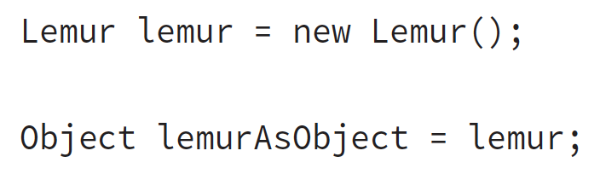
Understanding Polymorphism – Object VS Reference
- In Java, all objects can only ... using ... variable. As a developer, you shouldn't able to ... object.
- We should consider an object as a ... in ... (allocated by J...)
- No matter what type of ... is, the object will ...
- Although lemur is ...ed to Object class type, the real object is .... The only thing has changed is ... access ... (because Object class doesn't has ...)
- Therefore, we have 2 rules:
+)
+)
– Therefore, once we change ... => we have access ... although the member is ... before

Slide 38
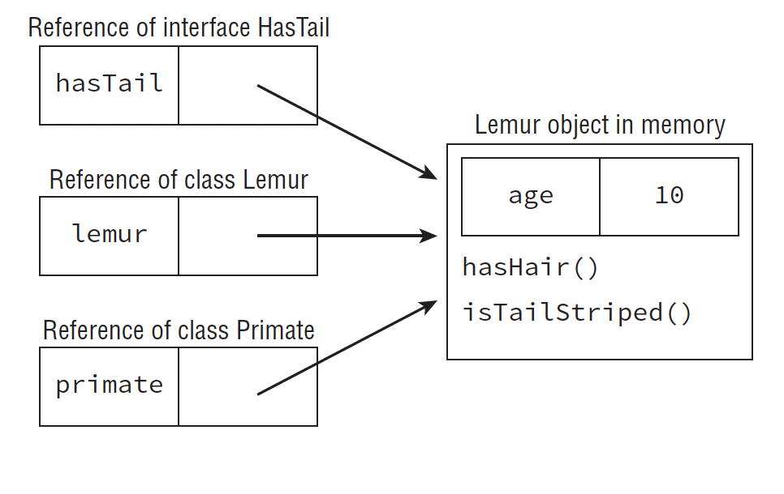
Understanding Polymorphism – Object VS Reference

Slide 39
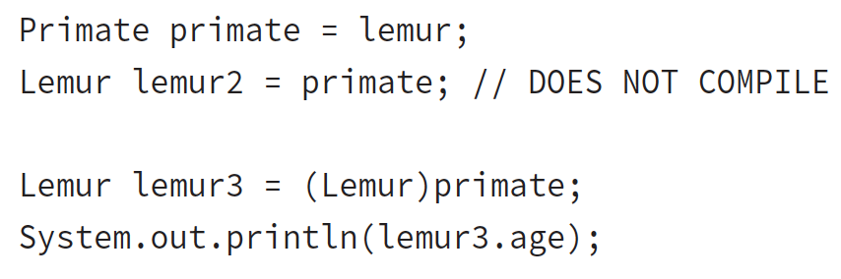
Understanding Polymorphism – Casting Object
- In order to access again, we need ... cast
(explicit cast = ... cast)
- We have 4 rules for casting object:
+)
+)
+)
+)
(code illustration snippet 67 - 68)

Slide 40
Understanding Polymorphism – Casting Object
- If we want to avoid ... like the Capybara example, we could use the ... operator to check whether ... the object is ...
(code illustration snippet 69)
Note: This is just an example, the ... operator is only disclosed in OCP exam

Slide 41
Understanding Polymorphism – Virtual Method
- The most important polymorphism ... is Virtual method
- Virtual method is the reason why we have ... – to support virtual method
– Virtual method is the method where its ... is not ... until ...
- The special point of virtual method is that when we call ... on a ... that ... the method => The ... will be ... (no matter which ... is used)
(code illustration snippet 70)
- So, we have know how to ... a method and now we also know how it relate to ...
– The nature of polymorphism is ..., by combining polymorphism and ..., we can see that an ... in runtime, especially in ... defined in ... class (ask question, Q1)

Slide 42
Understanding Polymorphism – Polymorphic Parameter
- One of the most important ... of polymorphism is to pass ... a method that accept ... or ... or ...
- For example, a method that accept a ... as a ... => We could pass a ... that its ... implement the ...
- And since this is ... => no explicit ...
=> We call this feature as Polymorphic Parameter
(code illustration snippet 71)
- In this example, if we try to pass ... as a parameter or ... as a parameter => ...
Polymorphic parameter and its relationship with code reusability
- If we try to define a ... that is accessible from ... or ... => we should use polymorphic parameter because it is considered as ...
(use List example)
(ask teacher about the Polymorphism and Method overriding section)

